Slide 1
8x client
WPF
8X application server ASP.NET Core
SQL server
REST API
8x client
WPF
8X application server ASP.NET Core
SQL server
4x client
VB6
REST API
Other system

Slide 2
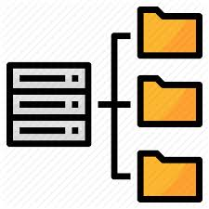
Պատվիրատուի ենթակառուցվածք
ՀԾ-ի ենթակառուցվածք
SQL server
Log server
(Seq)
8X application server
REST API
File storage
Telemetry server

Slide 3

REDIS
Telemetry server
8X application server
File storage
Log server
REST API
Reverse proxy
8X application server
SQL server

Slide 4
4x client
SQL server
ODBC, SQL, TDS
8x client
8X application server
REST API

